Slide 1
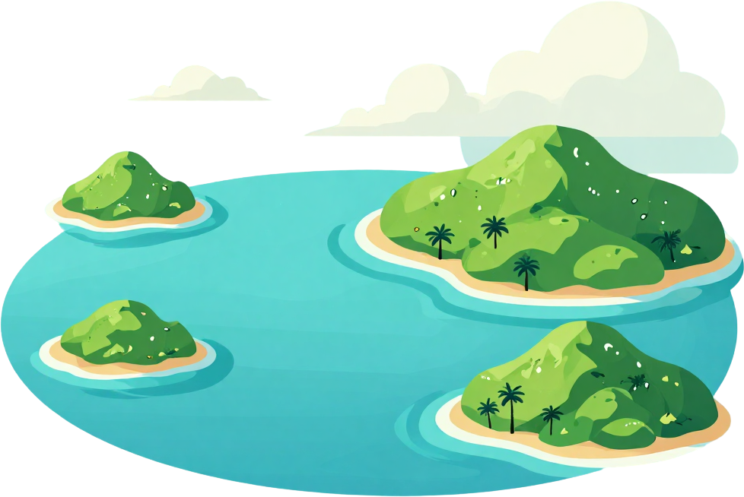
By: LOUIE ARMSTRONG.K.UITENI.FAONELUA
TONGA BETWEEN GENERATIONS: POPULATION GROWTH & CLIMATE IMPACT
A data visualization presentation exploring population dynamics and climate change impacts across Tonga's island communities.
Population Growth and Climate Change in a Pacific Island Nation, 2000-2026
August 24, 2026
Tonga, South Pacific

Slide 2
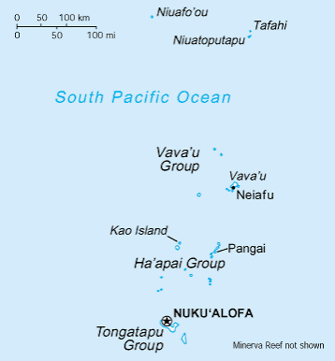
GEOGRAPHIC CONTEXT: THE TONGA ISLANDS
Despite its small land area, Tonga's coastline stretches thousands of kilometers. Low-lying atolls and coastal zones are highly vulnerable to sea level rise, storm surges, and coastal erosion — threats that grow more severe each decade.
Tonga consists of over 170 islands scattered across the South Pacific Ocean, organized into four main island groups: Tongatapu, Vava'u, Ha'apai, and 'Eua. The total land area is just 747 km², making land resources extremely limited.
Tonga's limited land area and extensive coastline make it one of the Pacific's most climate-vulnerable nations, with communities concentrated along exposed shorelines.

Slide 3

Tonga's population has grown from approximately 100,000 in 2000 to around 110,000 in 2026 — a modest 10% increase over 26 years. While growth is slow, its concentration in coastal urban areas amplifies pressure on the nation's limited island resources.
POPULATION GROWTH IN TONGA (2000–2026)
Urban Concentration: Over 70% of Tongans live on Tongatapu, the main island. Rapid urbanization around Nuku'alofa strains infrastructure, freshwater supplies, and coastal ecosystems.
Resource Pressure: Even modest population growth on small islands creates disproportionate demand for land, energy, food, and clean water — amplifying vulnerability to climate impacts.
~100,000 population in 2000 → ~110,000 in 2026 (~10% growth)
Urban share rising: majority concentrated in Tongatapu
Increased demand on limited land and freshwater resources
Coastal settlement growth heightens climate exposure

Slide 4

Tonga's society has undergone significant transformation between 2000 and 2026. Comparing the old and new generations reveals stark contrasts in lifestyle, consumption, and environmental impact across the islands.
The shift from traditional to modern living has reshaped Tonga's communities. Urbanisation, especially on Tongatapu, has accelerated resource demand and increased exposure to climate risks, while cultural ties to the land and sea remain deeply important.
Old Generation (2000)
Traditional village life and subsistence farming & fishing
Lower consumption and smaller environmental footprint
Strong cultural connection to land and sea
Community-based resource sharing
Today's Generation (2026)
Urbanisation and modern consumption patterns
Increased energy demand and waste production
Higher exposure to climate risks
Access to modern opportunities and technology
Urbanisation concentrated in Tongatapu
Rising resource demand on limited island land
Greater climate vulnerability in coastal zones
GENERATIONAL
COMPARISON

Slide 5
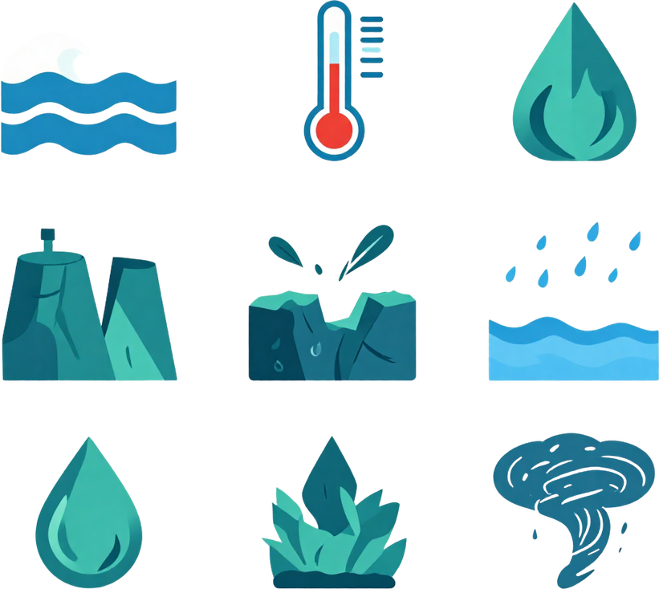
As a low-lying Pacific Island nation, Tonga is among the most climate-vulnerable countries in the world. The following slides detail each major climate threat in depth.
Tonga faces rising seas, warming temperatures, coastal erosion, freshwater threats, and stronger storms. These compounding climate pressures threaten the islands' ecosystems, communities, and long-term sustainability.
CLIMATE
CHANGE
IMPACT
Key Climate Threats:
Rising sea levels
Warming temperatures
Coastal erosion
Freshwater contamination
Intense tropical cyclones
Each climate impact compounds the next — creating cascading risks for Tonga's coastal populations and natural environment that demand urgent attention and adaptation.

Slide 6
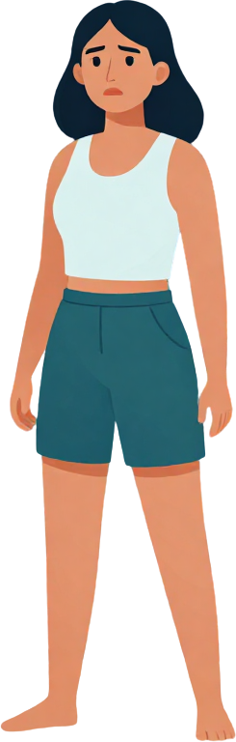
Tonga's low-lying islands are among the most vulnerable in the Pacific. Sea level rise driven by climate change poses an existential threat to coastal communities, freshwater supplies, and the cultural heritage of the Tongan people.
RISING SEAS & COASTAL VULNERABILITY
Saltwater intrusion contaminates freshwater lenses — the underground reserves that island communities depend on for drinking water and agriculture. As seas rise, these vital resources become increasingly threatened, putting food and water security at risk.
Coastal flooding events are increasing in frequency and severity, inundating homes, farmland, and critical infrastructure across Tongatapu and outer island groups.
Sea level rise of ~15 cm since 2000
Increased coastal flooding events
Saltwater intrusion in freshwater lenses
Erosion threatening homes and farmland

Slide 7

Rising sea surface temperatures above 28°C trigger mass bleaching events across Tonga's reef systems, with recovery periods shortening as anomalies intensify year over year.
Over 60% of Tonga's coral reefs show signs of bleaching stress. Healthy reefs buffer wave energy by up to 97%, making their decline a critical coastal vulnerability factor.
Tonga's mean sea surface temperatures have risen steadily since 2000, with anomalies exceeding +1.2°C by 2026. Warmer oceans trigger coral bleaching events, weakening reef structures that protect coastlines and support the fisheries that Tongan communities depend on for food and livelihoods.
TEMPERATURE ANOMALIES & CORAL REEF HEALTH
Temperature rising
Coral bleaching events
Fisheries declining
Coastal exposure up
Resilience threatened
Degraded coral reefs reduce coastal protection, accelerating erosion and storm surge damage. Declining fish stocks from reef loss threaten food security and the traditional fishing practices central to Tongan culture and economy.

Slide 8
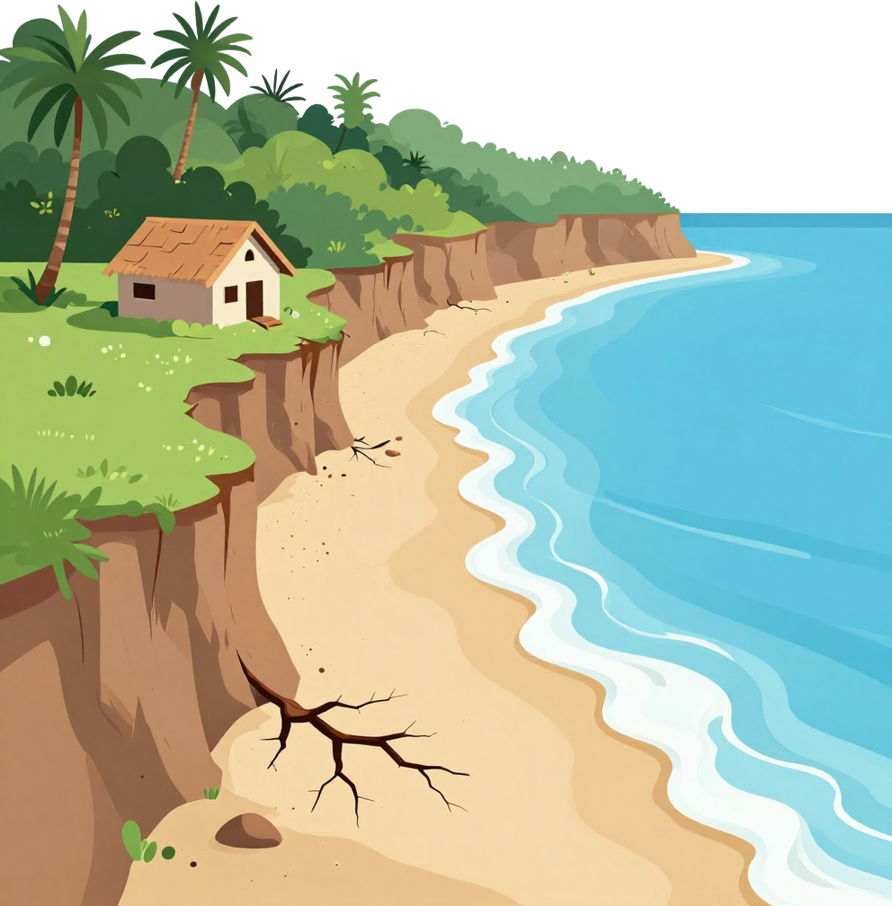
Coastal erosion is one of the most visible and damaging consequences of climate change in Tonga, steadily consuming land, destroying infrastructure, and threatening the cultural heritage of island communities.
Homes and infrastructure along coastlines are increasingly damaged or lost
Cultural sites and burial grounds are being swallowed by the sea
Loss of arable land intensifies food and livelihood insecurity
As sea levels rise and storm surges intensify, Tonga's coastal communities face growing vulnerability. The shrinking land area forces communities inland, strains limited resources, and erodes the deep cultural connections Tongans hold with their coastal environment. Without urgent adaptation measures, entire communities risk displacement and irreversible loss of land and heritage.
COASTAL EROSION & INFRASTRUCTURE THREATS

Slide 9
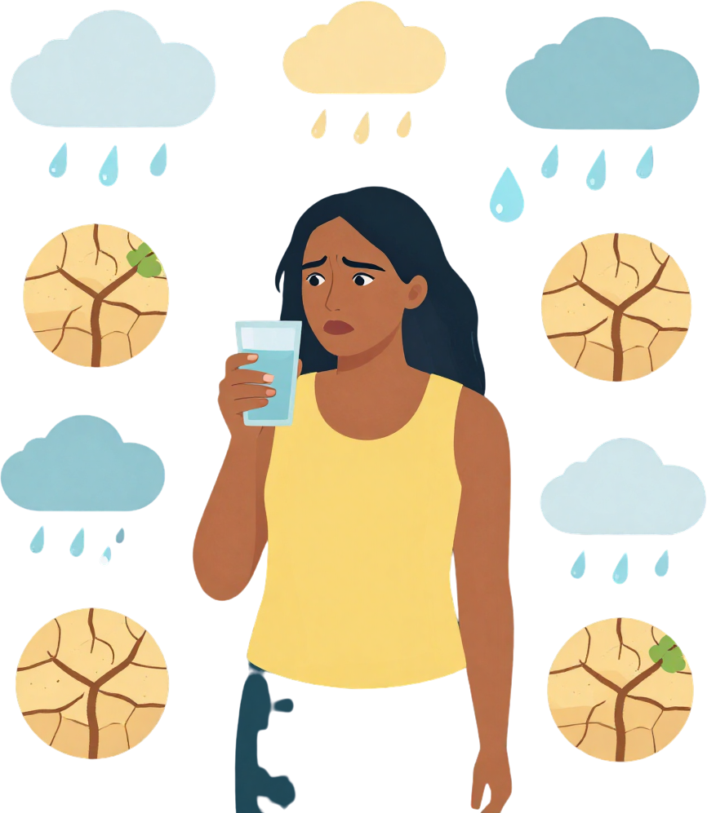
Tonga's freshwater supply is critically vulnerable. Rising sea levels drive saltwater intrusion into underground freshwater lenses, while shifting rainfall patterns create unpredictable cycles of drought and flooding that threaten communities across all island groups.
FRESHWATER THREATS & RAINFALL VARIABILITY
Saltwater intrusion contaminates the thin freshwater lenses beneath low-lying islands. As sea levels rise, saline water seeps into groundwater reserves — Tonga's primary drinking source — rendering wells unusable and forcing costly desalination measures.
Rainfall anomalies intensify water stress. Prolonged droughts reduce recharge of freshwater lenses, while intense rainfall events cause flooding and surface runoff, further degrading water quality and availability.
Saltwater intrusion into freshwater lenses
Rainfall variability causing droughts & floods
Declining groundwater quality and availability

Slide 10

Category 4–5 cyclones have increased in frequency over recent decades, with Cyclone Winston (2016) and Cyclone Harold (2020) causing devastating damage across Pacific island nations.
Coastal population density on Tongatapu means that a single major cyclone event can displace thousands, destroy freshwater supplies, and set back development progress by years.
Tonga's coastal communities face growing danger from intensifying tropical cyclones. As climate change warms Pacific waters, storm systems become more powerful and unpredictable, threatening lives, infrastructure, and livelihoods across the island groups.
EXTREME WEATHER EVENTS & POPULATION EXPOSURE
Intensifying cyclone strength
Rising storm surge levels
Increased coastal flooding
Infrastructure destruction
Displacement & recovery burden
Recovery costs from extreme weather events consume a disproportionate share of Tonga's GDP, limiting investment in long-term climate adaptation and resilience infrastructure.

Slide 11

As Tonga's population grows toward 110,000 by 2026, the demand for land, water, energy, and food intensifies. With over 70% of residents concentrated in Tongatapu, pressure on limited island resources has reached a critical threshold, compounding the effects of climate change.
Coastal zones — already vulnerable to sea level rise and erosion — bear the greatest population density. This convergence of demographic growth and climate exposure creates compounding risks. While Tonga's carbon emissions remain minimal globally, local environmental impacts are severe and escalating.
Urban concentration in Tongatapu strains freshwater lenses, waste systems, and coastal land, accelerating environmental degradation.
Balanced development and climate adaptation strategies are urgently needed to protect communities and sustain island ecosystems.
Growing demand for land, water, energy & food
Coastal zone concentration heightens climate risks
Local impacts severe despite minimal emissions
Balanced development & adaptation strategies needed
POPULATION PRESSURE AMPLIFIES ENVIRONMENTAL STRESS

Slide 12
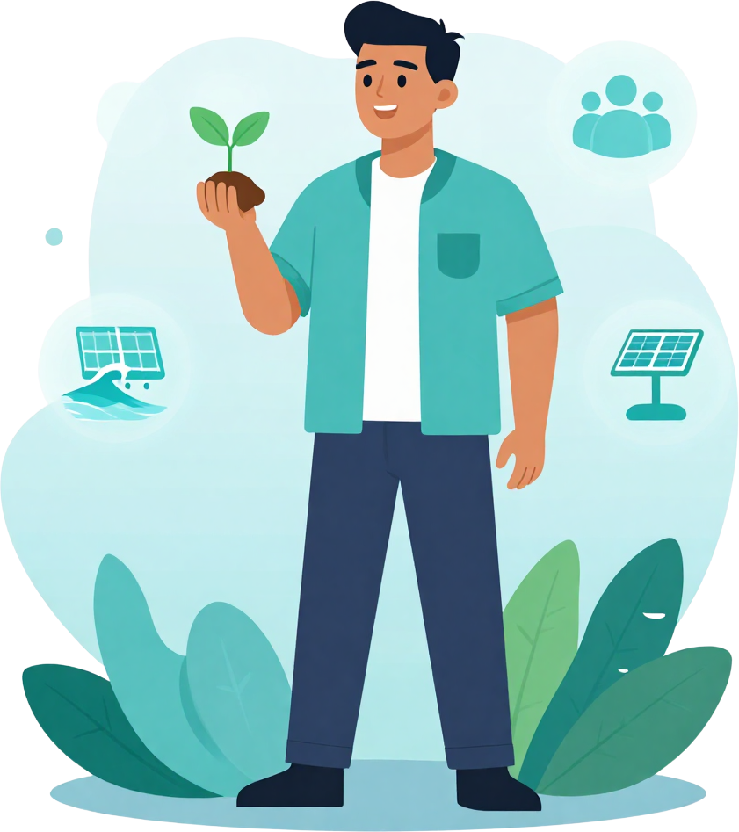
Tonga's future depends on bridging generations — combining the wisdom of traditional practices with the tools of modern innovation. Sustainable development, climate resilience, and community empowerment are not just goals, but necessities for a nation facing rising seas, shifting weather, and growing population pressure on limited island resources.
SUSTAINABILITY OUTLOOK
Traditional Knowledge: Ancestral practices in land stewardship, fishing, and community resilience offer proven, sustainable models for living in harmony with Tonga's fragile ecosystems and coastal environment.
Modern Innovation: Renewable energy, climate-adaptive infrastructure, and data-driven planning empower Tonga's communities to face climate risks while preserving culture and identity.
"Protecting Tonga's islands and people for generations to come" — sustainable development and climate resilience start with community empowerment today.

Slide 13

Population Growth & Climate Impact
Tonga, South Pacific
THANK YOU
FOR YOUR TIME
Protecting Tonga's islands and people for generations to come. Together, we can bridge traditional wisdom and modern innovation to build a resilient, sustainable future for the Pacific.
Tonga Between Generations
August 24, 2026

