Slide 1







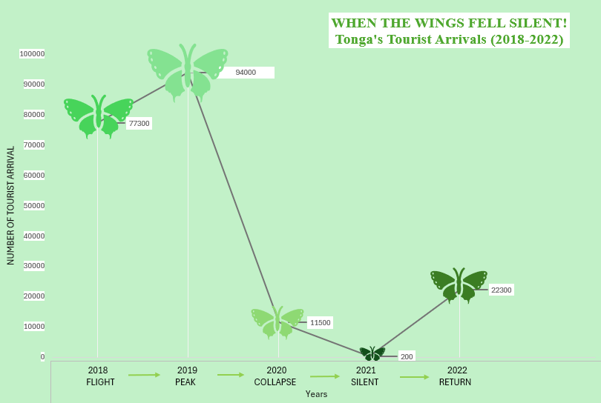
TONGA -TOURIST ARRIVALS (2018-2022)
“ Tourism can fall fast but it can also recover”
Our Island. Our Data. Our Future
BUTTERFLY SYMBOLIZE HOPE IN LIFE!
“When the Wings Fell Silent”
Tonga’s tourism story is a story of flight, silence, and recovery.
From the data, in 2019, there were 94,000 tourist arrivals. This year, tourism in Tonga reached its highest point. The Wings of Tonga’s Tourism were flying high.
Suddenly, everything changed.
Tourist arrivals decreased to 11500 in 2020. By 2021, few tourists arrived around 200. At the same time, the wings that once carried thousands had almost fallen.
Our graph shows vulnerability, disruption and the beginning of recovery. We are looking for a solution on how to build a Tourism sector that is strong enough to withstand future challenges.
Tonga’s changing climate can escalate risks to Tourism through rising temperatures, sea level rise and more extreme weather, which can threaten our natural environment and communities that attract visitors. Our tourism wings may rise again, but building climate resilience is essential to keep them flying into the future.
OUR DATA
Dataset: Tourist Arrival
Country: Tonga
Years: 2018-2022
Source: Pacific DataViz Challenge
Year | Tonga-Tourist Arrival
2018 | 77,300
2019 | 94,000
2020 | 11,500
2021 | 200
2022 | 22,300
GREEN symbolizes the natural beauty of Tongan Island, the Growth and renewal after disruptions and a HOPE for the future of Tonga Tourism.
Queen Salote College Geographic Team

