Slide 1
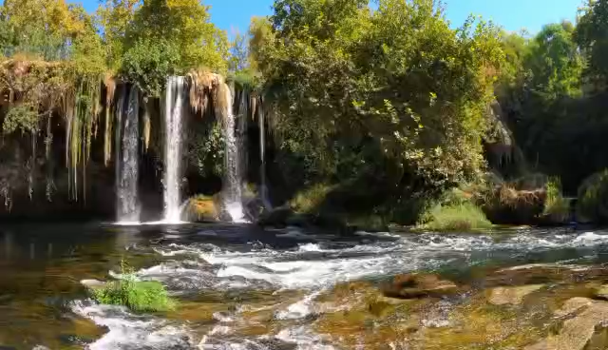

Slide 2
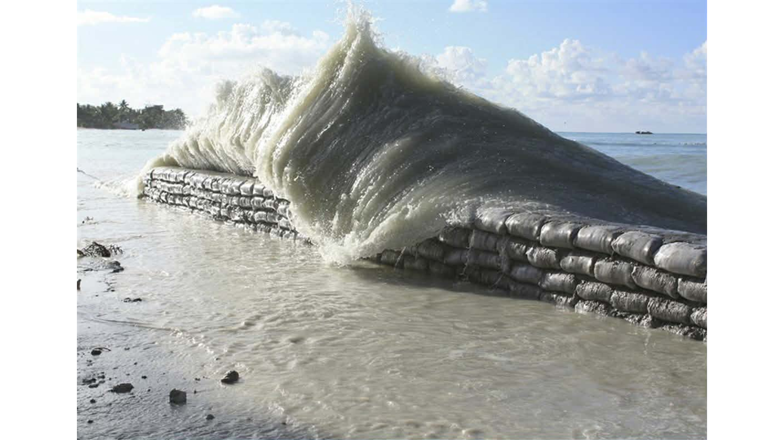
GENERAL AIM:
To investigate the impact of climate change that contribute to sea level rise in Kiribati.
To understand how sea level rise affects the environment and people of Kiribati.
To identify possible ways to reduce or manage the effect of sea level rise.

Slide 3
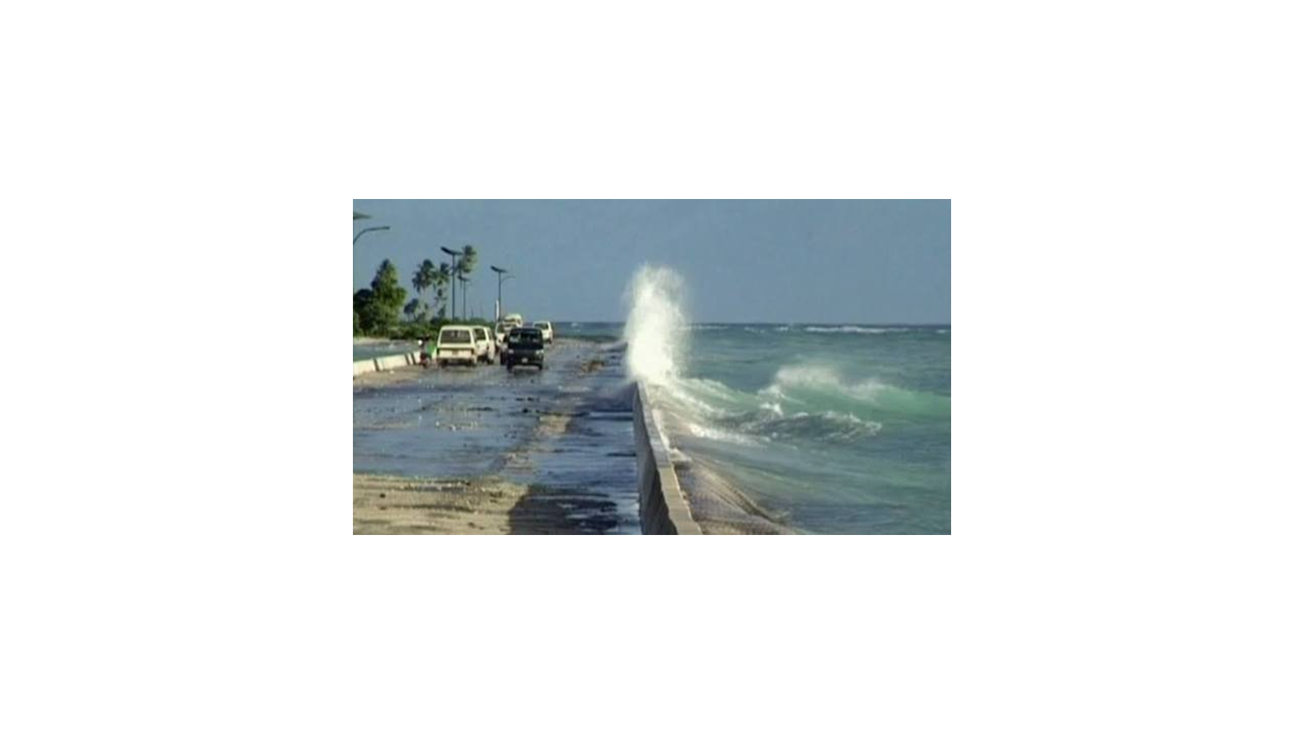
Specific Objective
To examine the causes and effect of sea level rise in Kiribati.
To investigate how sea level rise affects home, lands, water, and coastal communities.
To identify solutions and actions that the government and communities can take to adapt to sea level rise.

Slide 4
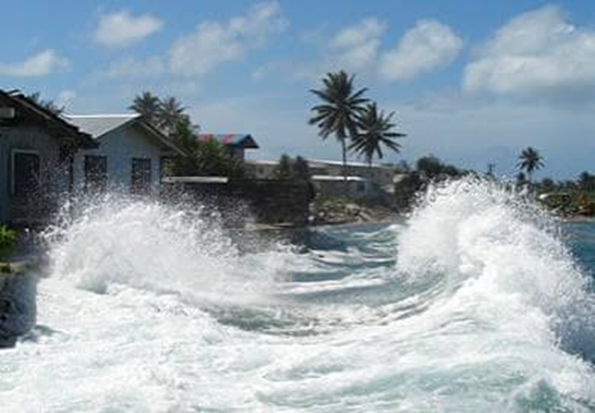
Introduction
Kiribati is a small island country located in the central Pacific Ocean. It is made up of many low-lying atolls and islands, with much of its land only a few metres above sea level. Because of its low elevation, Kiribati is highly vulnerable to climate change, especially sea level rise. Rising sea levels can cause coastal flooding, coastal erosion, and saltwater to enter freshwater sources and agricultural land. These problems can affect people’s homes, roads, food production, water supply, and livelihoods. Scientific studies show that sea level around Kiribati has been rising and is expected to continue rising in the future. Therefore, climate change and sea level rise are major challenges for the future of Kiribati and require strong adaptation and protection measures.

Slide 5
FIGURE—1
Source: Illustrative data created for educational purposes; percentages are not official measurements.

Slide 6
ANALYSIS:
The bar graph shows the impact of sea level rise in Kiribati from 2020 to 2024. In 2020, the effect was 29%, but in 2021 it rose sharply to 44%, showing that flooding and coastal damage became much worse. The percentage dropped to 30% in 2022, suggesting a temporary improvement, but then increased again to 35% in 2023. By 2024, the impact reached 40%, showing that the problem is still growing.
Moreover, the graph highlights a fluctuating but upward trend. Even though the numbers go up and down, the long‑term pattern shows that Kiribati is facing more serious challenges from sea level rise. This means that the country’s land, homes, and resources are becoming more vulnerable each year.
The key message is that sea level rise is not steady but cumulative, and its effects are becoming harder to manage. Kiribati needs strong action to protect its people and land, such as building coastal defenses, restoring mangroves, and working with global partners to fight climate change.

Slide 7
FIGURE—2
Source: Estimated from NASA Sea Level Change Team (2024) data on sea-level rise in Kiribati.

Slide 8
ANALYSIS:
This line graph shows how the impact of sea level rise in Kiribati has changed between 2020 and 2024. In 2020, the impact was quite high at 38%, but it dropped sharply to 22% in 2021. After that, the numbers climbed again, reaching 30% in 2022 and peaking at 53% in 2023. By 2024, the impact fell slightly to 43%, but it still remained higher than most previous years.
The graph tells a story of ups and downs, like waves on the ocean. Some years bring relief, but others hit harder, showing that the threat is unpredictable and growing. The sharp rise in 2023 is especially worrying, as it shows how quickly conditions can change and affect island life.
Therefore, the message is clear: Kiribati is living on the frontline of climate change. Even when the numbers dip, the long‑term trend shows danger rising. This calls for creative solutions and strong action to protect homes, land, and the future of the island people.

Slide 9
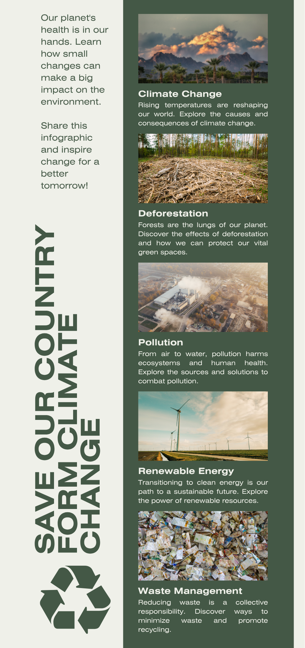
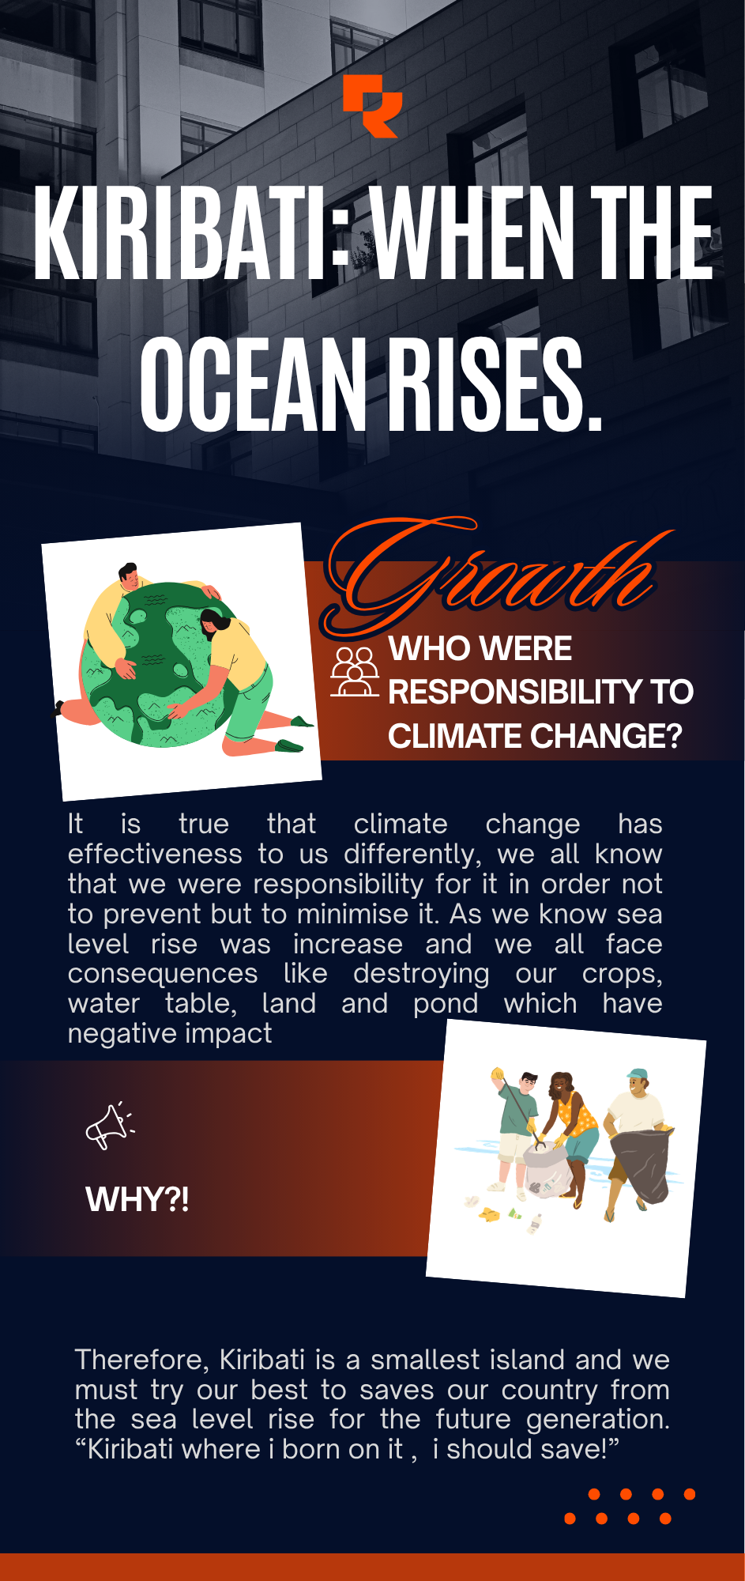

Slide 10
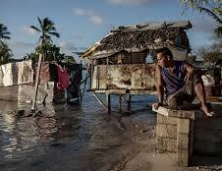
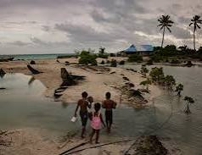
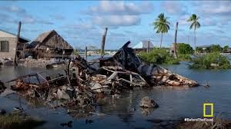
EFFECTIVENESS OF CLIMATE CHANGE (SEA LEVEL RISE ) TO OUR BELOVED COUNTRY KIRIBATI.
The pictures clearly show that climate change and sea-level rise are having serious effects on Kiribati. The first picture shows seawater entering a village, which can damage houses, roads and crops. The second picture shows coastal erosion, where rising sea levels and strong waves remove land from the coastline. The third picture shows flooding and damage to homes and property, which can make it difficult for people to live safely in their communities. Overall, the pictures indicate that sea-level rise is threatening land, homes, food production and the safety of people in Kiribati.

Slide 11
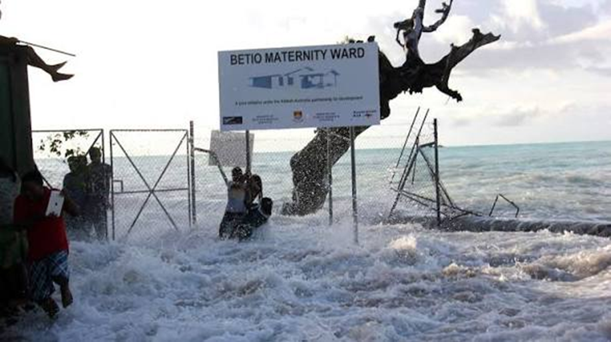
Analysis
The image shows the effect of sea-level rise and coastal flooding on Betio Maternity Ward in Kiribati. Large waves and seawater have entered the hospital area, showing that important health facilities are vulnerable to coastal flooding. Sea-level rise increases the normal level of the ocean, making high tides, storm surges and large waves more likely to reach inland areas. This can damage hospital buildings, make roads difficult to use, and create problems for pregnant women, babies and health workers. Therefore, the image demonstrates how climate change and rising sea levels can threaten health services and people's safety in low-lying areas of Kiribati.

Slide 12
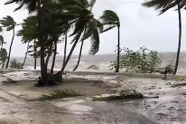
Image 1: Large waves are reaching homes and coastal areas. This shows how higher sea levels can make coastal communities more exposed to wave flooding, coastal erosion, and damage to houses and infrastructure. Kiribati's low-lying islands are especially vulnerable because much of the land is only a few metres above sea level.
Image 2: Strong waves and water are moving inland while palm trees are being affected by strong winds. This represents coastal flooding and storm impacts. Sea-level rise makes these events more dangerous because the starting sea level is already higher, allowing waves and storm surges to reach further inland.

Slide 13
Analysis of the image in relation to sea-level rise
The image shows Betio Maternity Ward in Kiribati being affected by seawater and large waves. The water has reached the hospital area, showing how vulnerable important health facilities are to coastal flooding.
Coastal flooding: Rising sea levels make it easier for seawater to move onto low-lying land. Kiribati's atolls are very low, so even a small increase in sea level can increase flooding risk.
Impact on health services: Flooding around a maternity ward can make it difficult for pregnant women, mothers, babies, patients, and health workers to safely access the hospital.
Damage to infrastructure: The image shows waves reaching the fence and buildings around the ward. Repeated flooding can damage buildings, roads, equipment, and other public infrastructure.

Slide 14
DISCUSSION
To investigate the impact of climate change and its contribution to sea level rise in Kiribati.
Climate change contributes to sea level rise mainly because higher global temperatures cause ice sheets and glaciers to melt. Warmer ocean water also expands, which increases the level of the sea. For low-lying islands such as Kiribati, even a small rise in sea level can have serious effects.
2. To understand how sea level rise affects the environment and people of Kiribati.
Sea level rise can cause coastal erosion, flooding, and damage to homes and roads. It can also cause saltwater to enter freshwater sources and agricultural land, making it difficult for people to get clean water and grow crops. This affects both the environment and the daily lives of people in Kiribati.
3. To identify possible ways to reduce or manage the effects of sea level rise.
Kiribati can manage the effects of sea level rise by protecting coastal areas, planting mangroves, improving drainage systems, and building stronger infrastructure. The government and communities can also increase awareness about climate change and prepare plans to protect people and important areas from flooding.

Slide 15
FINDINGS
To examine the causes and effects of sea level rise in Kiribati.
Sea level rise is mainly caused by climate change. Rising global temperatures cause glaciers and ice sheets to melt, while warmer ocean water expands. In Kiribati, sea level rise can lead to flooding, coastal erosion, and damage to the natural environment.
To investigate how sea level rise affects homes, land, water, and coastal communities.
Sea level rise can flood homes and damage buildings, roads, and other important infrastructure. It can also cause land erosion and reduce the amount of land available for people. Saltwater may enter freshwater sources and agricultural land, affecting drinking water and food production. Coastal communities are especially vulnerable because many people live close to the sea.
To identify solutions and actions that the government and communities can take to adapt to sea level rise.
The government and communities can adapt by planting mangroves, protecting coastal areas, improving drainage systems, and building stronger infrastructure. Communities can also avoid building in highly vulnerable areas and increase awareness and preparedness for flooding. Working together can help Kiribati better manage the effects of sea level rise.
THE GOVERNMENT WILL FIND POSSIBLE SOLUTIONS IN ORDER TO MINIMISE THE AFFECTION FROM THE CLIMATE CHANGE (SEA LEVEL RISE), IN THIS CASE OUR COUNTRY IS SMALL AND WE NEED THE ADAPTATION FROM OUR GOVERNMENT TO SAVE OUR KIRIBATI TE BOBOTO.
!!!
!!!

Slide 16
CLIMATE CHANGE SYMBOL
KEYS:
Outer Circle – Climate Change (Yellow): This represents the global driver. Climate change is the overarching environmental challenge caused by greenhouse gas emissions, deforestation, and unsustainable practices.
Second Circle – Sea Level Rise (Green): One of the most direct consequences of climate change. Melting ice caps and thermal expansion of oceans lead to rising seas, which threaten low-lying islands.
Third Circle – Consequences for Islanders (Turquoise): Rising seas translate into real human impacts: loss of land, flooding, saltwater intrusion into freshwater, destruction of homes, and threats to food security. Islanders are among the most vulnerable communities.
Innermost Circle – Call to Action (Blue): The core message: “We need to take action to protect our country.” This emphasizes responsibility, resilience, and urgency. It’s not just about awareness—it’s about mobilizing solutions like coastal protection, renewable energy, and global cooperation.
CLIMATE CHANGE
SEA LEVEL RISE
ISLANDERS FACE SERIOUS CONSEQUENCES
WE MUST ACT NOW TO PROTECT OUR COUNTRY

Slide 17
RECOMMENDATION
Strengthen coastal protection: The government should use both natural and strong coastal protection methods, such as planting mangroves, protecting coral reefs, using traditional the buibui, and building properly designed seawalls in highly vulnerable areas. Protect freshwater supplies: Communities should increase rainwater harvesting, improve water storage, and protect freshwater areas from saltwater contamination caused by sea-level rise. Raise public awareness and education: Schools and communities should provide more education about climate change so young people and local communities understand the causes, effects, and ways to adapt. Improve climate-resilient infrastructure: New homes, roads, hospitals, and other important buildings should be designed and built to better withstand flooding, coastal erosion, and extreme weather. Increase international support: Kiribati should continue working with international partners to receive financial and technical support for climate adaptation projects because protecting low-lying islands requires significant
long-term investment.

