Slide 1
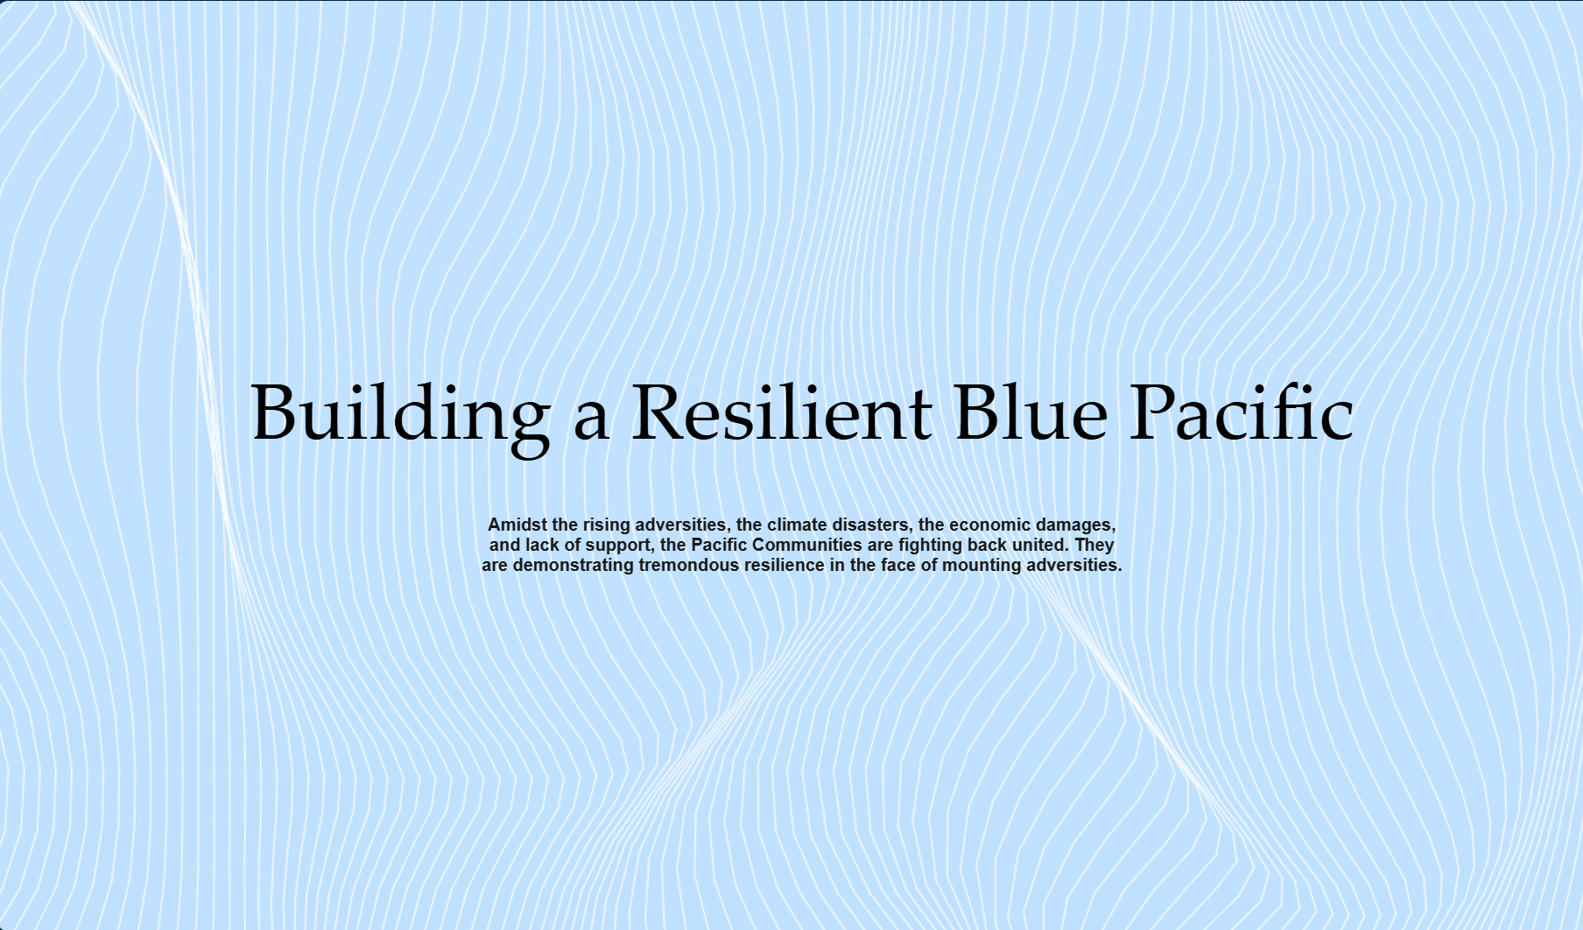

Slide 2
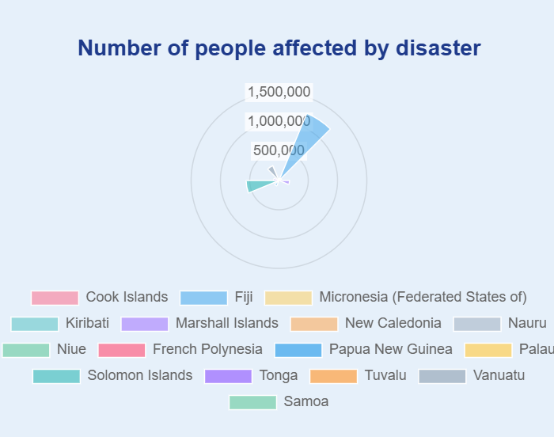
A Wake-Up Call from the Pacific
🌊 Over 2.58 million people have been affected by disasters across the Pacific Islands — a staggering figure that underscores the region's vulnerability.
On average, 136,009 people are impacted every year, highlighting the urgent need for coordinated action and resilience-building efforts.

Slide 3
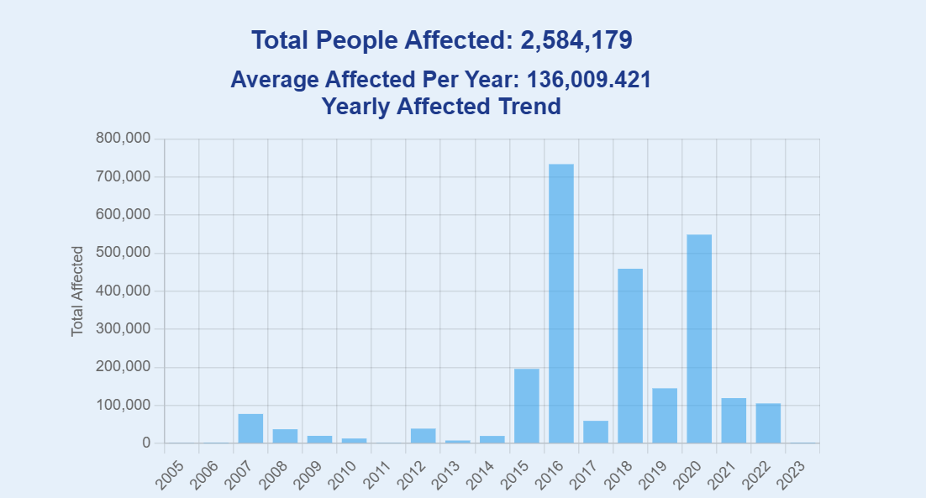

Slide 4
Top Affected Countries
Country | 2010 | 2011 | 2012 | 2013 | 2014 | 2015 | 2016 | 2017 | 2018 | 2019 | 2020 | 2021 | 2022 | 2023 | Total
Fiji | 6644 | 344 | 37085 | 0 | 0 | 0 | 633584 | 0 | 155726 | 78045 | 235921 | 78030 | 1787 | 0 | 1227166
Solomon Islands | 1456 | 36 | 216 | 7577 | 14831 | 18586 | 60858 | 51465 | 194155 | 1834 | 2339 | 240 | 20080 | 0 | 540973
Vanuatu | 500 | 248 | 28 | 0 | 152 | 0 | 0 | 920 | 23286 | 18 | 246802 | 1400 | 0 | 0 | 273354
Marshall | 0 | 0 | 0 | 0 | 280 | 0 | 27452 | 7029 | 0 | 35844 | 56718 | 0 | 52914 | 0 | 180237
Tonga | 0 | 345 | 0 | 0 | 4520 | 0 | 0 | 0 | 84311 | 640 | 68 | 0 | 0 | 0 | 89884

Slide 5
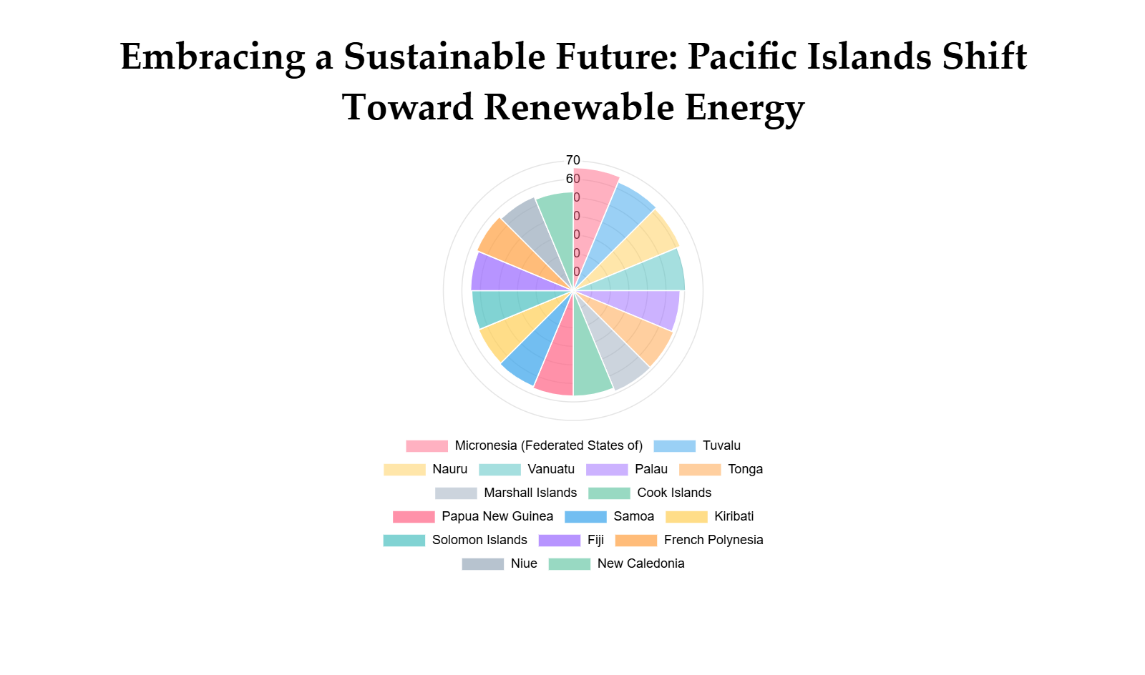

Slide 6
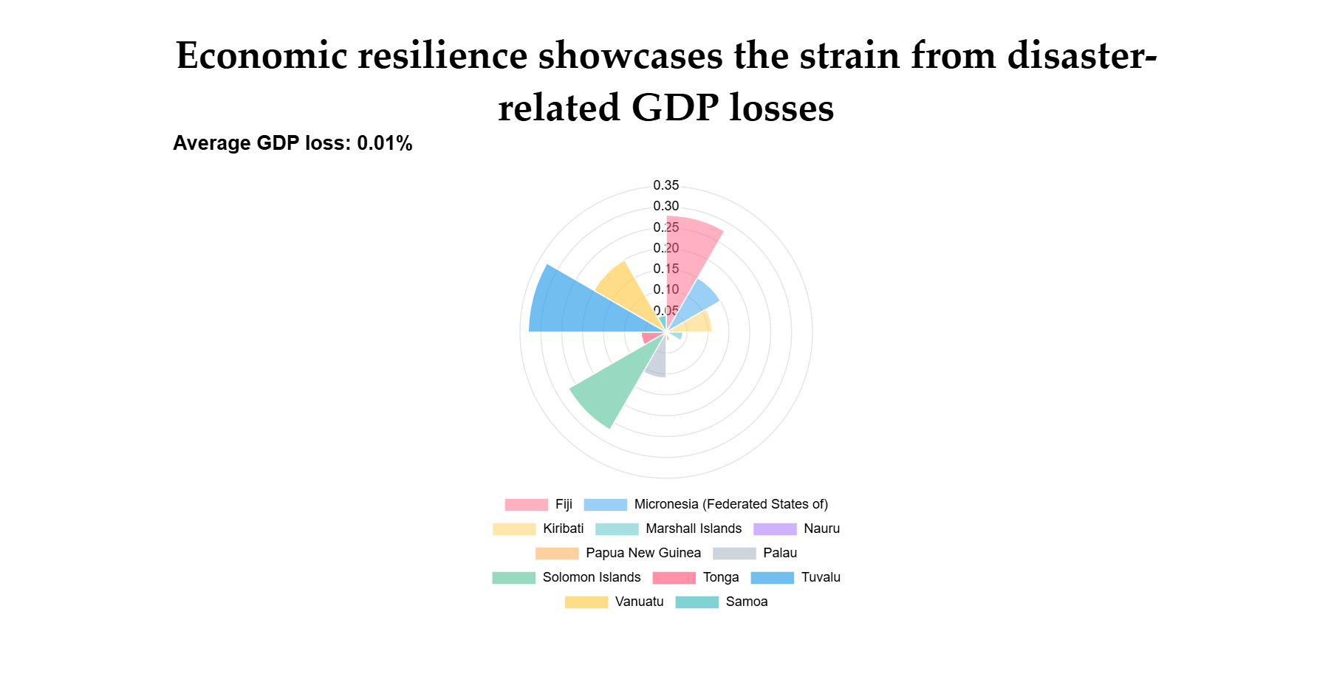

Slide 7
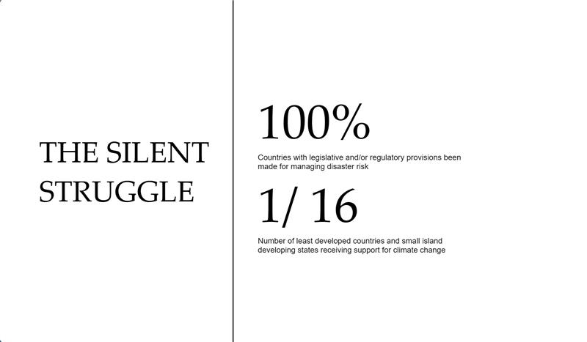

Slide 8
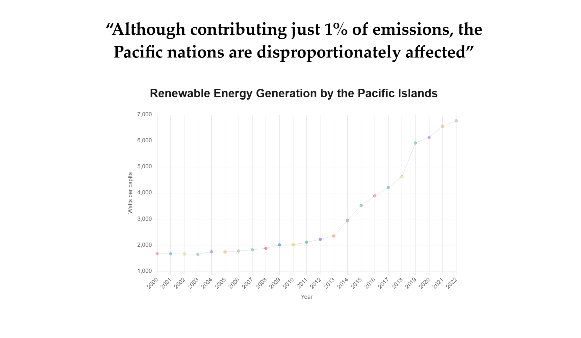

Slide 9
Conclusion
Pacific Island communities showcase remarkable resilience, facing climate challenges despite contributing just 1% to global emissions, enduring growing disaster impacts and economic strain.
Rising seas, storms, and economic losses threaten livelihoods and culture, with disaster tolls escalating (e.g., hundreds of thousands affected) and renewable energy potential underexploited.
It’s our duty to support them with tailored renewable projects, improved data, and global partnerships, recognizing them as equal partners in sustainability.
Act now—fund resilient infrastructure, enhance preparedness, and collaborate to save lives and preserve their future.
With our support, the Blue Pacific can lead in climate resilience, inspiring global action.

